Slide 1
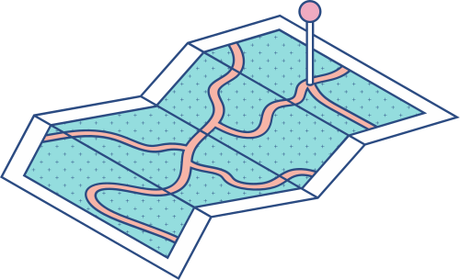





Data Science
Logistic Regression(ML)
meet-irfan

Slide 2



Agenda
KEY TOPICS DISCUSSED IN THIS PRESENTATION
Logistic Regression Sigmoid Function Cost Function Optimization (Gradient Descent) Conclusion

Slide 3

Logistic Regression
Supervised ML algorithm for binary classification.
Predicts probabilities (0 to 1) using a sigmoid function.
Real-world Applications:
Spam detection (Spam vs. Not Spam).
Medical diagnosis (Disease vs. No Disease).
Credit scoring (Default vs. No Default).

Slide 4
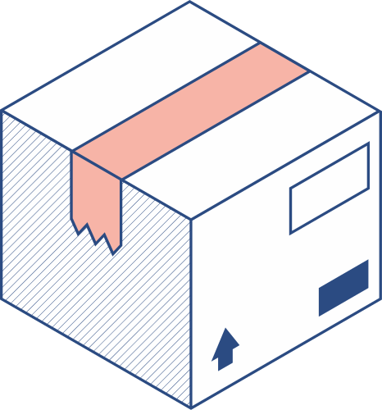


Why Not linear Regression
Problem with Linear Regression for Classification: Output is unbounded (can be <0 or >1). Sensitive to outliers. | Solution: Logistic Regression squashes output to [0,1] using sigmoid.

Slide 5
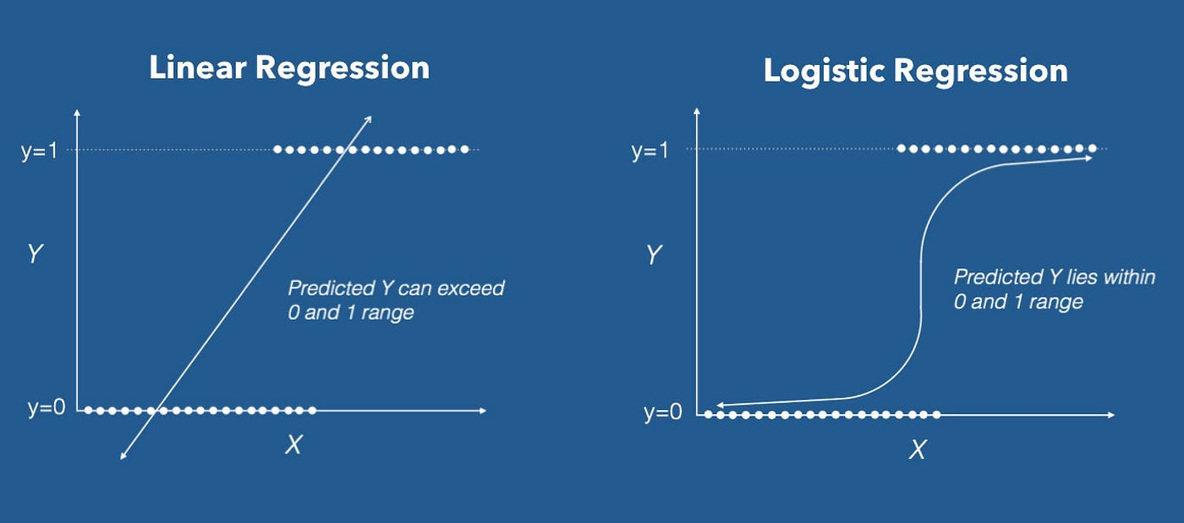

Slide 6
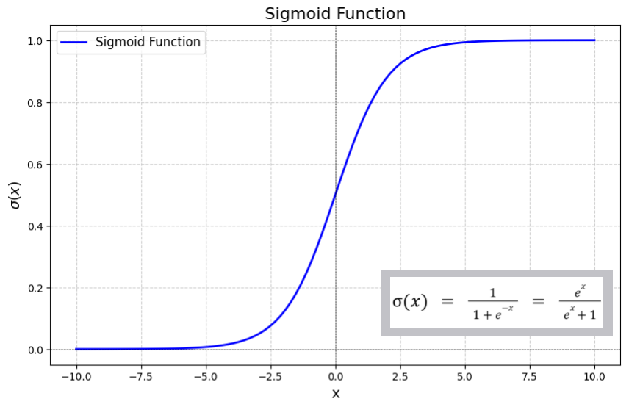
Sigmoid Function (Key Formula)
Properties:
S-shaped curve.
Outputs probability P (y=1/x)
Threshold = 0.5 (default).

Slide 7

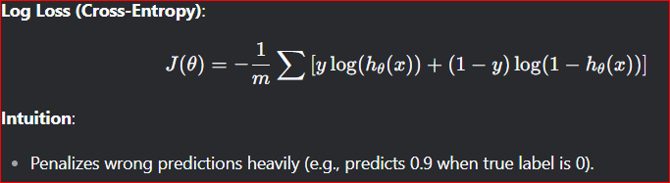
Cost Function (Log Loss)
Why not MSE? → Non-convex for logistic regression.

Slide 8

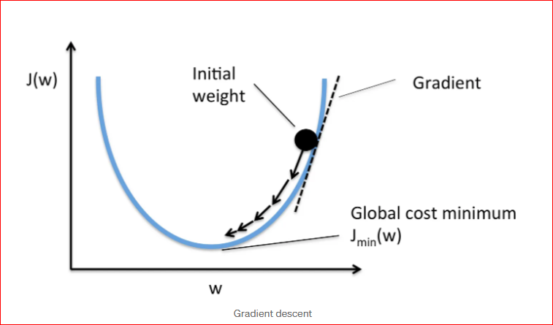
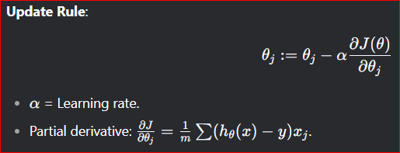
Optimization (Gradient Descent)
Goal: Minimize J(θ) by updating weights θ

Slide 9


Conclusion Logistic regression = Probability + Classification. Uses sigmoid, log loss, and gradient descent.

